Slide 1


Slide 2

Where I started?
Started with less knowledge of development of full fledged projects.
Never did a project with full defined process of modelling a project i.e. diagrams to code.
Pre Learning materials helped in clearing basic concepts.

Slide 3
Framework for 3 Weeks
16 days plan.
Each day progress report was seen, which included code review, UML diagrams review, Database review by Trainer.
Proper doubts were cleared of each student.
Regular Assignments were given which led to development of project.
MCQ based Test was conducted after each topic.
Training were as per schedule provided before by the company.

Slide 4
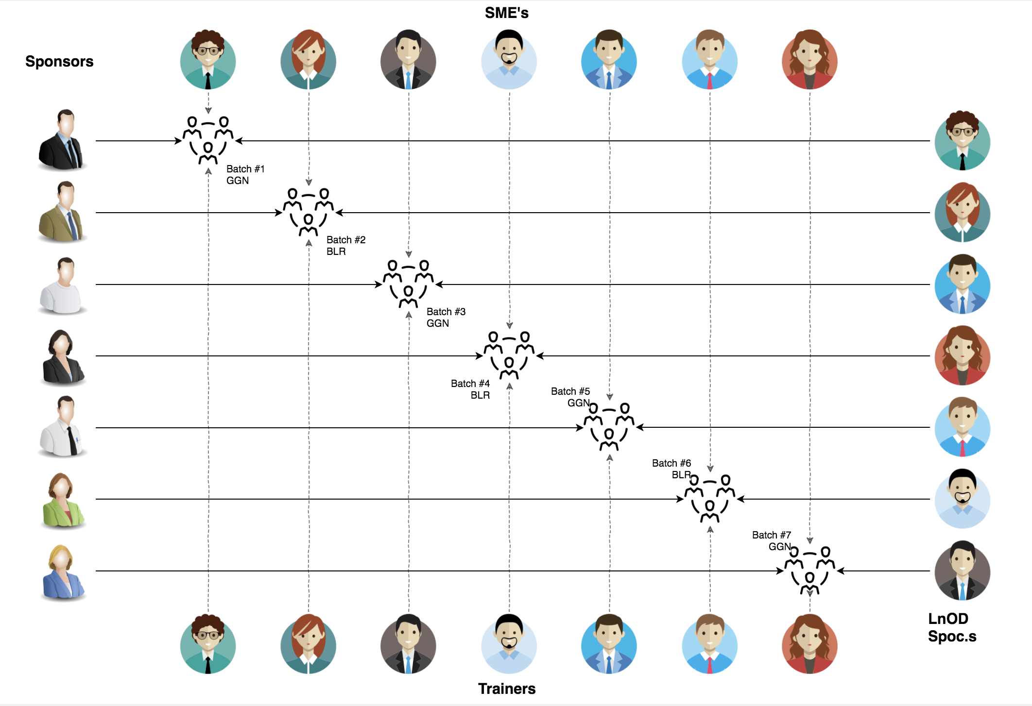
Stakeholders
Sponsors
Flipkart
SME’s
Trainer
Others HR & Experts
Trainers
Trainers
Assess
Course-Corrections

Slide 5
Our next starts
NOW
Notes:
Time – 1 min
Swati

Slide 6
3 Weeks of Training + Project demo
16 DAYS
128 HOURS
7680 MINUTES
6,91,200 SECONDS
Limitless knowledge

Slide 7

Agenda
01
Our Journey
02
Our Team
03
Project Goals
Engineering Practices
04
05
Tech Stack
06
Development
Challenges & Learnings
07
08
Demo
09
Questions
Notes:
Time – 1 min

Slide 8

Our Journey
Notes:
Time - 2 mins

Slide 9
Pre reads were provided before the training.
We started with UNIX.
GIT/GITHUB was covered in the second phase that included all important aspects that can be used for storing repositories.
For Project View, SDLC was the next topic where deep insight was provided for the process and design principles.
For depicting the project, the concepts of various UML diagrams was included.
Core Java concepts were learnt to make clear understanding of the project by which the code was implemented simultaneously.
REST web services also helped to build the client functionalities that connects with other systems.
Drop Wizard was used as tool to deploy REST Web Services.

Slide 10
Agenda of Sessions:
1. Introduction to the UNIX 2. Introduction to GIT and GITHUB 3. SDLC and OOAD with UML modelling 4. Core Java Programming 5. MySQL Fundamentals 6. Dropwizard 7. Project Work

Slide 11
Demo
Mindset
Process
5
Project Demo
Tools
4
Adapting to a developer
Mind
Comprehend
3
Deployment through Design
2
Decide the Technologies Java/REST
1
Understanding Project Goals

Slide 12

Our Team
Notes:
Time – 2 mins

Slide 13

Amit Kr. Balyan
(Trainer)
Siddharth Arya
(Trainee)

Slide 14

Project Goals
Notes:
Time – 3 mins

Slide 15




Our Vision
To create an Student Management System using Java Development Tools , MYSQL having three users:-
Student
Professor
Admin
who can perform operations and further deployment using REST and Dropwizard.
1
2
Quality
Security
3
4
Interactivity
Speed
Notes:
User satisfaction and brand value

Slide 16

Engineering Practices
Notes:
Time – 5 mins

Slide 17
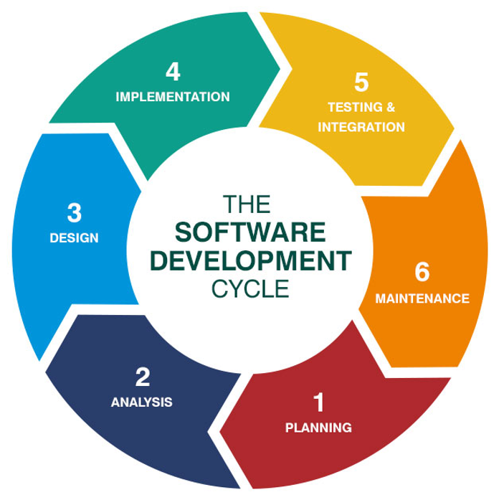
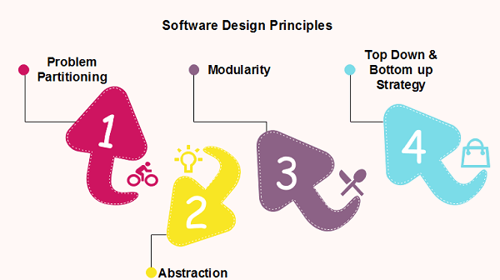

Slide 18

Tech Stack
Notes:
Time – 2 mins

Slide 19









Framework
Backend
Data
Tools
Framework
Core Language
SQL Database
UI for MySQL
Application Server
Version Control
Notes:
Time – 1 min

Slide 20

Development
Notes:
Time – 1 min

Slide 21
Project Planning
Project
Grooming
Requirement understanding
Development
Integrate
Research and analysis
Estimation
Deploy
Test
Code Review
Commit
Delivery
Project Impleme-ntation
Modelling
Scope
Notes:
Time – 1 min

Slide 22
Modelling Diagrams
Notes:
Time – 5 mins

Slide 23
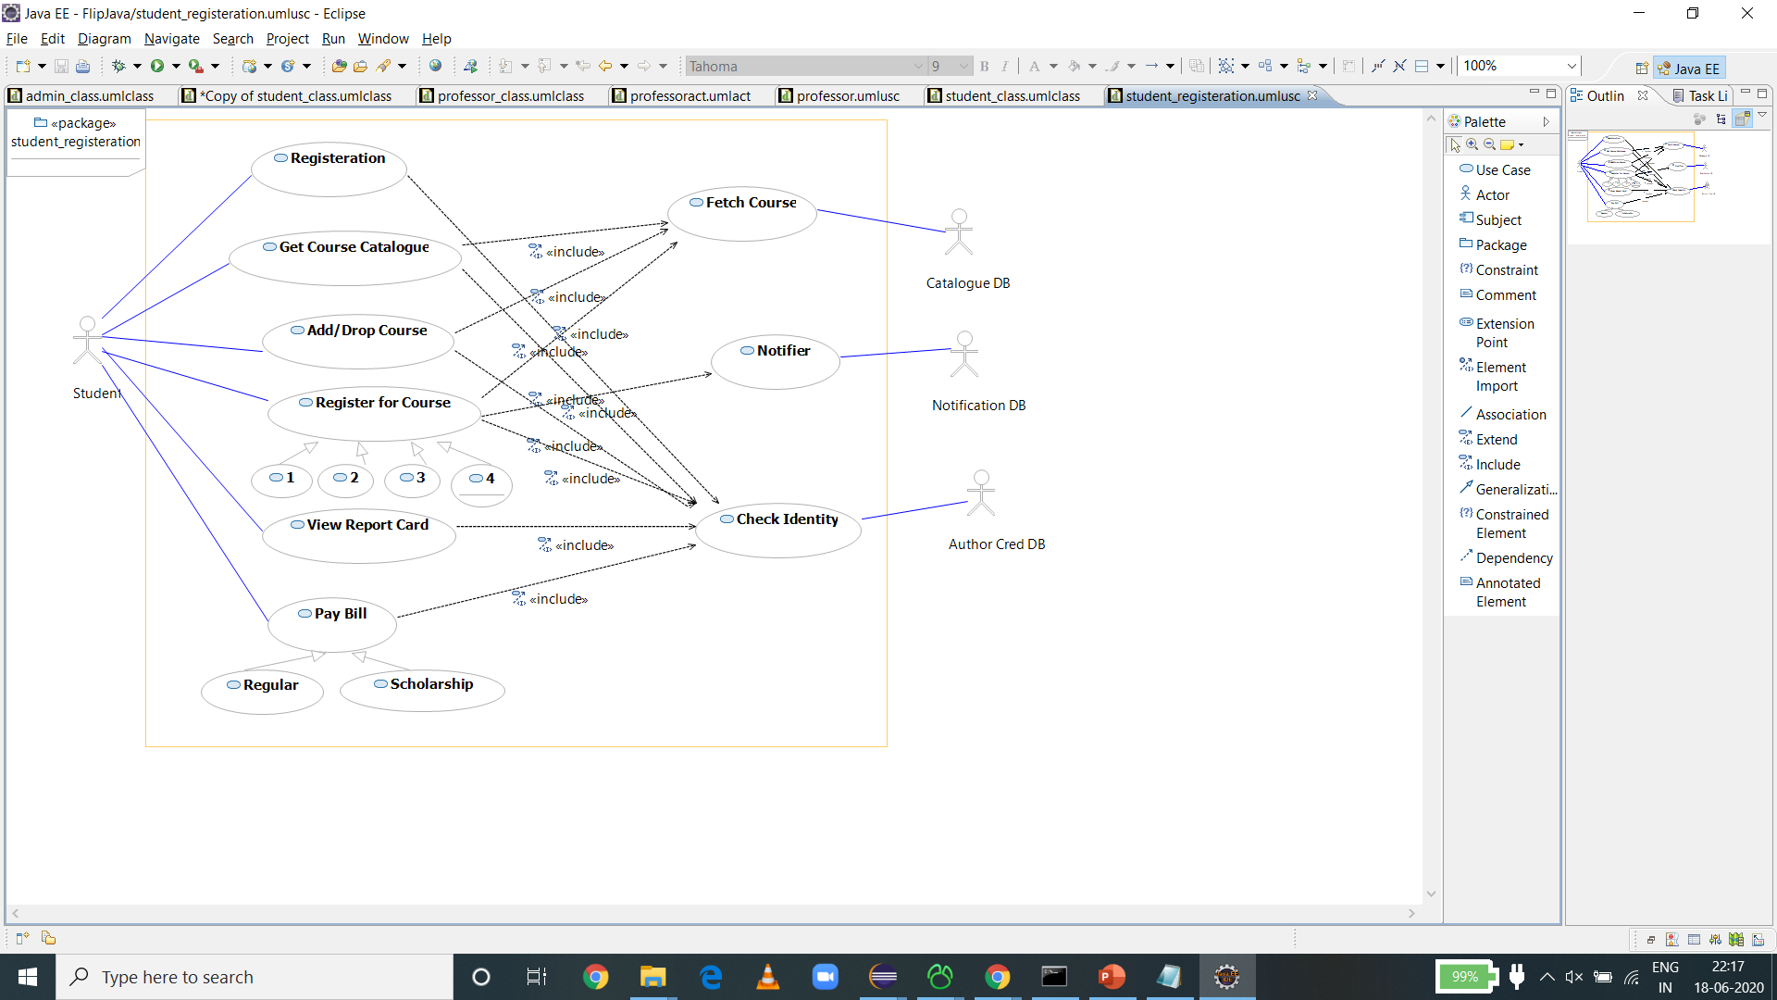
Student Use Case Diagram

Slide 24

Professor Use Case Diagram

Slide 25

Admin Use Case Diagram

Slide 26
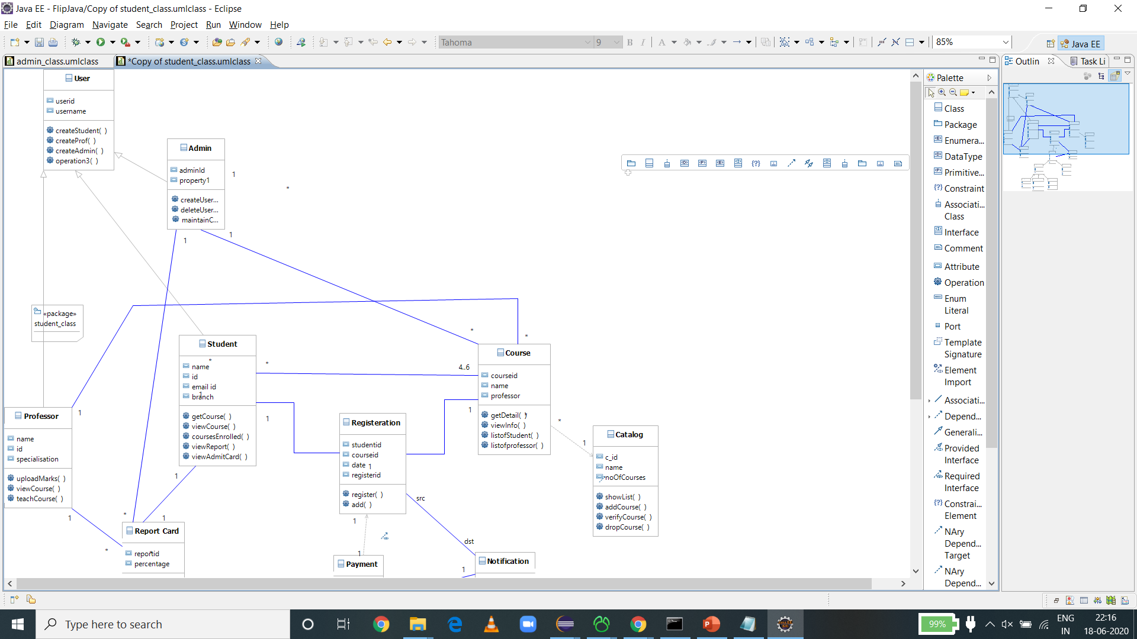
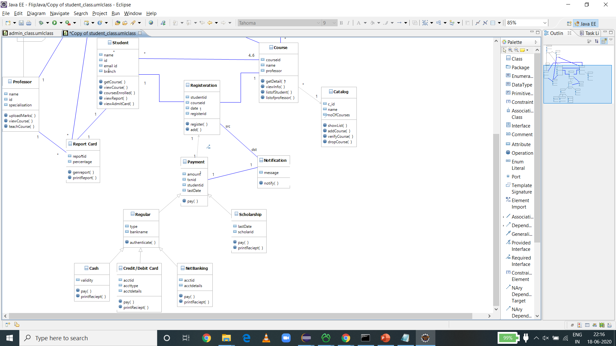
Class Diagram

Slide 27
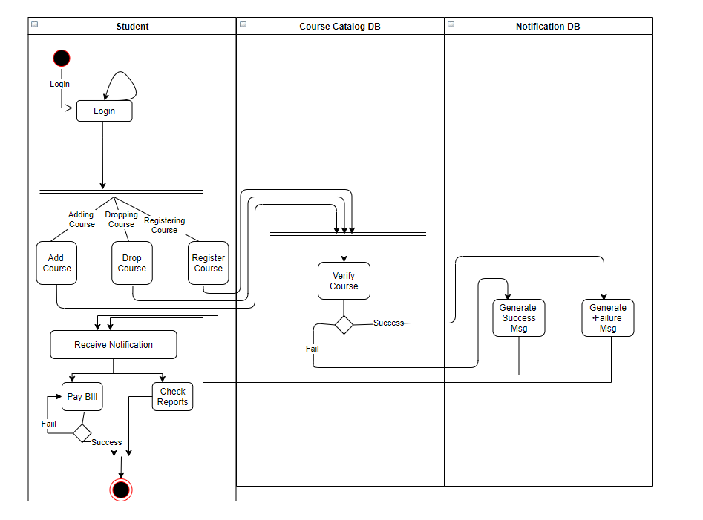
Student Activity Diagram

Slide 28
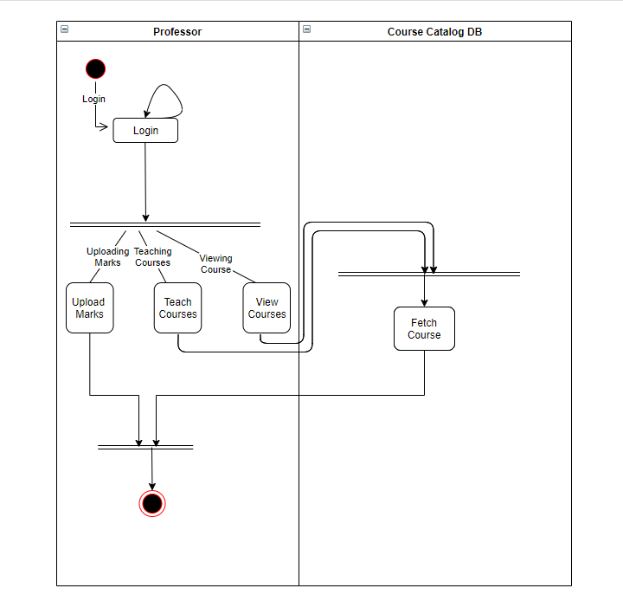
Professor Activity Diagram

Slide 29
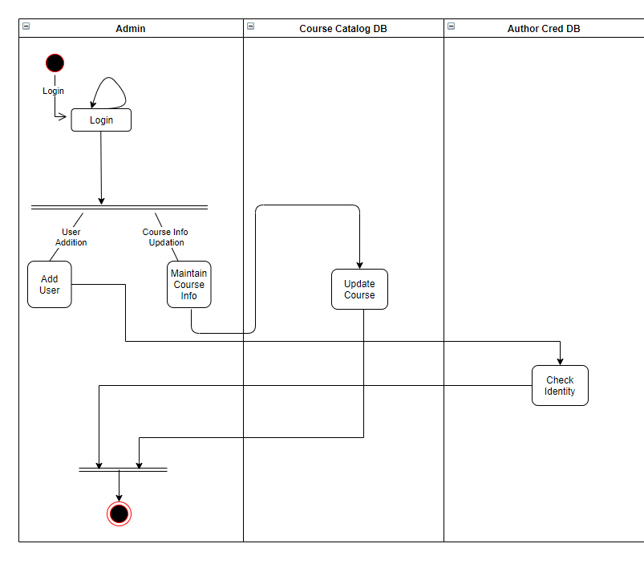
Admin Activity Diagram

Slide 30
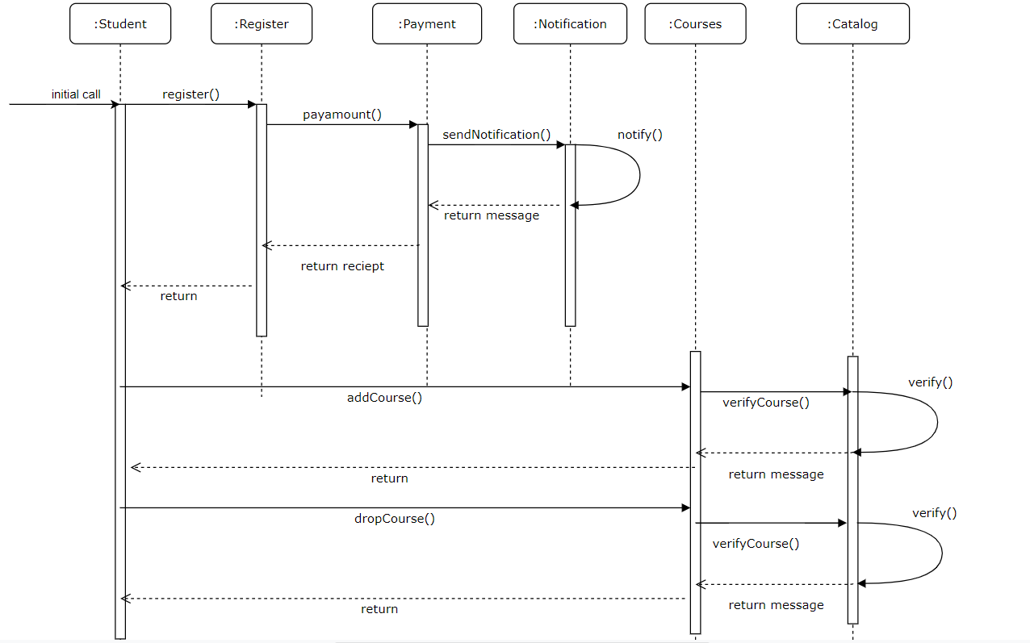
Student Sequence Diagram

Slide 31
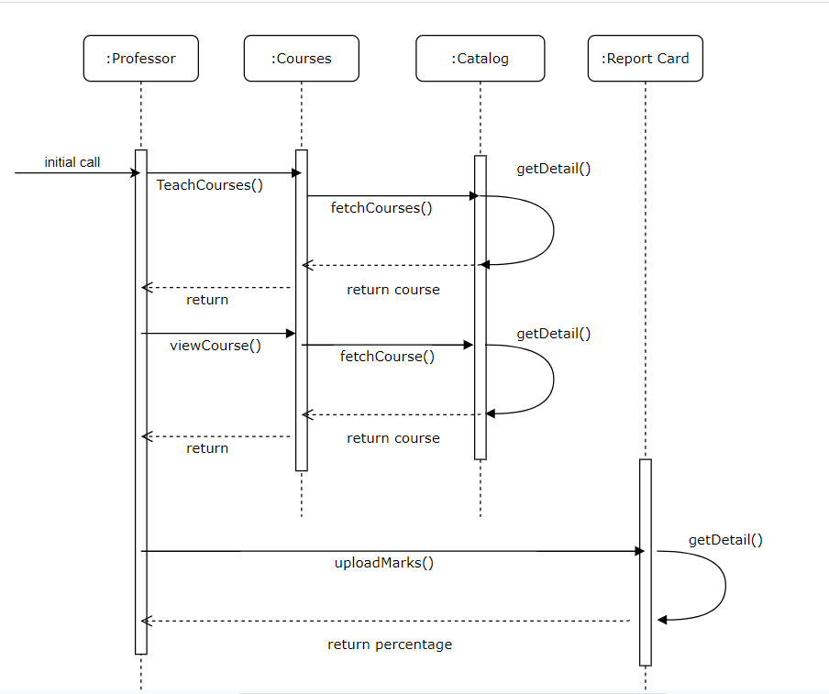
Professor Sequence Diagram

Slide 32
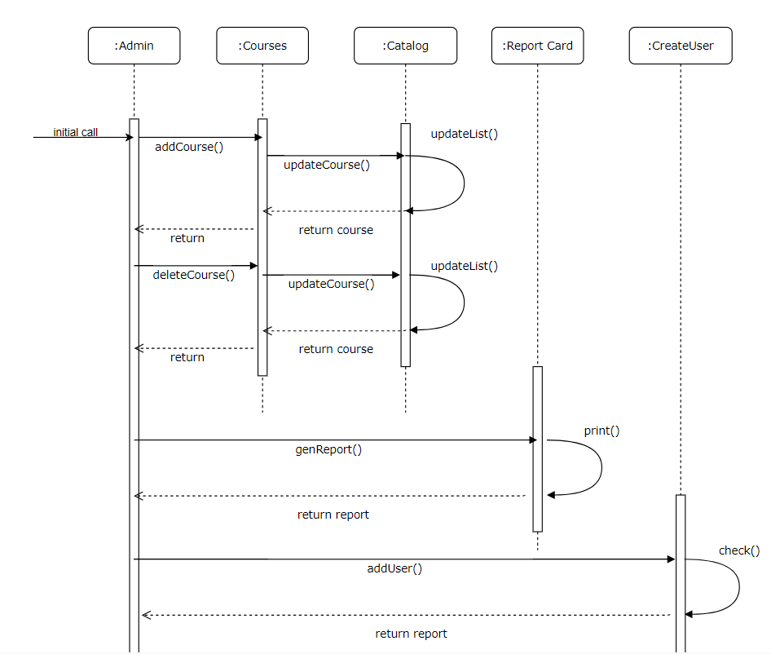
Admin Sequence Diagram

Slide 33

UML to Code Transformation
Notes:
Time – 2 mins

Slide 34
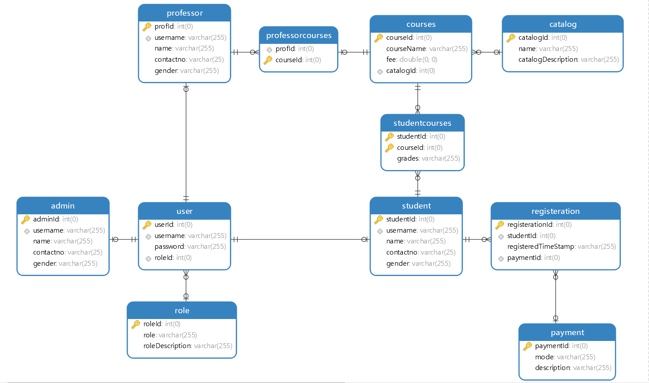
Database Schema

Slide 35

Challenges & Learnings
Notes:
Time – 2 mins

Slide 36
Challenges:
Analysing the scope of program
Need to refactor code many times to make code accurate in terms of reusability or good code practices.
Learning:
Should design database first, else cause refactoring of code.
Model design should be done properly, can affect thought process of a model.
Design patterns should be followed.

Slide 37

Demo
Notes:
Time –
Architecture – 5 mins
NFR Dashboard – 3 mins
Demo – 10 mins
1. Show the Responsiveness and Wave tool first

Slide 38

Questions
Notes:
Time - ?

Slide 39
Thank you
Notes:
Time – After this show the testimonial video. 1 min

